Slide 1
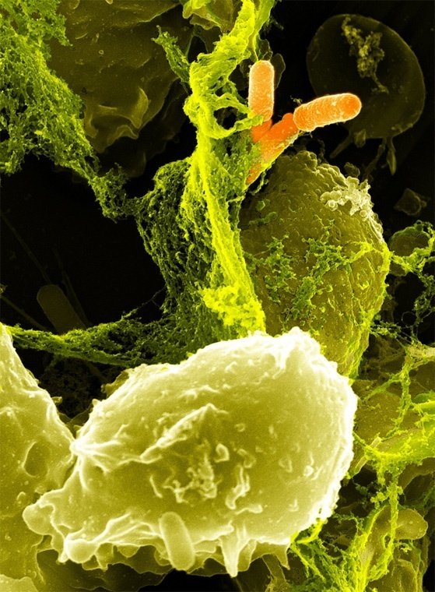
SHIGELLA
Mamita Rai Gurung

Slide 2
General characteristics
The genus is named after Kiyoshi Shiga, who first discovered it in 1897.
Gram-negative, facultative anaerobic, nonspore forming, non-motile, non capsulated, rod-shaped bacteria closely related to Salmonella.
They are short gram negative rods of about 0.5μm-1.3μm in size.
Shigella belong to the bacterial family, Enterobacteriaciae.
Fimbriae may be present
Do not produce H₂S(Hydrogen sulphide)
Do not produce gas from glucose (except for S. flexneri).
Causative agent of bacillary dysentry ( Shigellosis)
Are found only in human intestine.
Highest incidence of shigellosis occur in areas of poor sanitation and where water supplies are polluted.

Slide 3
Shigellosis
Also known as bacillary dysentery or Marlow Syndrome, in its most severe manifestation.
Is a foodborne illness caused by infection by bacteria of the genus Shigella.
Symptoms may range from mild abdominal discomfort to full-blown dysentery characterized by cramps, diarrhea, with slimy-consistent stools, fever, blood, pus, or mucus in stools.Onset time is 12 to 96 hours, and recovery takes 5 to 7 days.

Slide 4
The genus Shigella is divided into four species:
Shigella dysenteriae (Subgroup A)-consisting of 13 serotypes
Shigella flexneri (Subgroup B)- consisting of 15 serotypes
Shigella boydii (Subgroup C)-consisting of 18 serotypes
Shigella sonnei (Subgroup D).-consisting of a single serotype
Each of these subgroups, with the exception of S. sonnei, has several serotypes

Slide 5
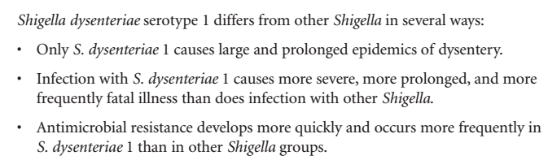
Out of the four species of Shigella, S. dysenteriae and S. flexneri are the most common in developing countries and produce the most severe form of shigellosis.

Slide 6
Antigenic structure
Somatic O antigens:- O-antigen is the component of the lipopolysaccharide (LSP) present on the outer membrane of the bacteria.The serological classification of Shigella is based on this O antigen.
capsule (K antigen)

Slide 7
Virulence Factors
Endotoxin: Shigella releases toxic lipopolysaccharides which contributes to the irritation of bowl wall.
Exotoxin:Esp S. dysenteriae type 1 produce heat labile exotoxin that affects both the guts and central nervous system.
Invasive factors: NF-kappa B(Nuclear factor), tumor necrosis factor (TNF)-α(involved in inflammation)(S. flexneri, S. sonnei)
Capacity to replicate intracellularly
(Exotoxins are toxic substances secreted by bacteria and released outside the cell. Whereas Endotoxins are bacterial toxins consisting of lipids that are located within a cell.)

Slide 8
Transmission
Fecal-oral transmission is the main path of Shigella infection. Other modes of transmission include ingestion of contaminated food or water, contact with infected objects
Outbreaks of Shigella infection are common in places where sanitation is poor.
Ingestion of an extremely low number of bacteria, 10 to 100, can cause infection
incubation period is only 1-7 days, averaging 3 days

Slide 9
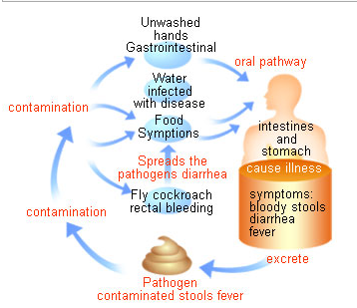

Slide 10
Pathogenesis
Shigella infections is usually limited to the gastrointestinal tract
Blood stream invasion is quite rare
The essential pathological process is the invasion of the mucosal epithelial cell( eg M cell) by induces phagocytosis, escape from the phagocytic cell , multiplication and spread to within adjacent cells by propulsive movements of actin. This way, the bacteria avoid antibody-mediated humoral immunity.
Microabscesses in the wall of the large intestine and terminal Ileum leads to the necrosis of the mucus membrane .
Superficial ulceration, bleeding and formation of a “pseudomemdrane” on the ulcerated area.

Slide 11
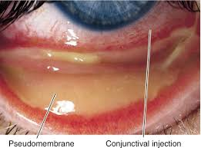

Slide 12
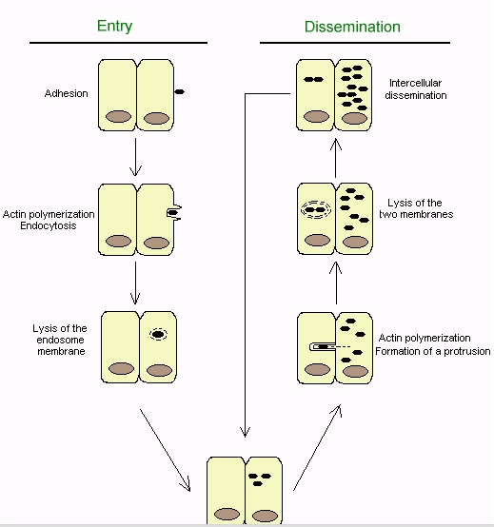

Slide 13
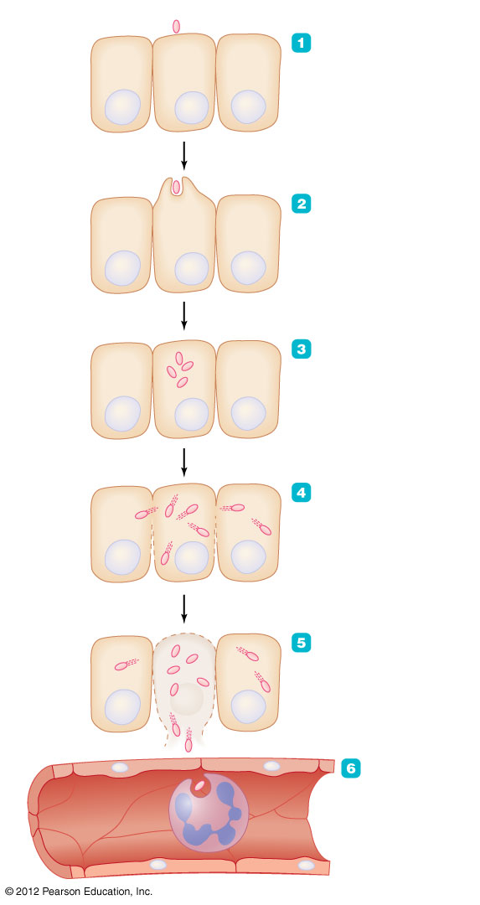
Figure 23.7 The events in shigellosis
Shigella
Shigella attaches to
epithelial cell of colon.
Epithelial cell
Nucleus
Shigella triggers
endocytosis.
Shigella multiplies
in cytosol.
Actin fibers
Shigella invades
neighboring epithelial
cells, thus avoiding
immune defenses.
Mucosal abscess
An abscess forms as
epithelial cells are killed
by the infection.
Blood vessel
Phagocyte
Shigella that
enters the blood
is quickly
phagocytized
and destroyed.
No bacteremia.

Slide 14
Clinical manifestation
Ranges from asymptomatic infection to severe bacillary dysentery
Two-stage disease: watery diarrhea, abdominal pain, fever (infection in Small intestine) changing to dysentery( infection in colon and ileum) with frequent small stools with blood and mucus, tenesmus , cramps, fever .
Watery diarrhea attributed to the enterotoxic activity of Shiga toxin
Fever attributed to neurotoxic activity of toxin

Slide 15
Exotoxin-Shigatoxin
Enterotoxic effect
Shiga toxin adheres to small intestine receptors and blocks absorption (uptake) of electrolytes, glucose, and amino acids from the intestinal lumen.
Cytotoxic effect
B subunit of Shiga toxin binds host cell glycolipid in large intestine, A1 domain internalized via receptor-mediated endocytosis and cause irreversible inactivation of the 60S ribosomal subunit, thereby inhibiting protein synthesis, causing cell death, microvasculature damage to the intestine, and haemorrhage (blood and faecal leukocytes in stool).
Neurotoxic effect
Fever and abdominal cramping are considered signs of neurotoxicity.CNS abnormalities can also occur and include lethargy, disorientation, seizures, paralysis and coma. Neurotoxicity occurs most often in children and the elderly and is often fatal.

Slide 16
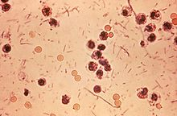
Lab diagnosis
Sample: faeces that may be watery and blood stained or rectal swab
Microscopy:Gram’s staining
- Gram negative rods.Large number of RBCs and pus cells are observed in stool sample.

Slide 17
Culture
Aerobic and facultative anaerobic, incubated at 37 degree celcius for 24 hrs.
Enrichment media
Selenite F broth(contains sodium selenite that inhibit coliforms and supports Salmonella-Shigella growth)
Selective media
XLD (Xylose lysine deoxycholate)-produces red pink colonies without black centre.
In MA(Mac Conkey, NonLactose Fermentor(NLF) colonies are seen i.e. Colourless colonies(except S sonnei which ferments lactose, after 48 hrs)

Slide 18
Contd.........
DCA (Deoxycholate citrate)- produces NLF pale colored colonies except S sonneii
SS (Salmonella Shigella): produce creamy white colonies.
HE (Hektoen enteric) Agar-produce bluish-green colonies
Transport media:
Cary Blair media

Slide 19
Biochemical test
Shigella species are non lactose fermenters. (except S. sonnei can ferment lactose).
They typically do not produce gas from carbohydrates (with the exception of certain strains of S. flexneri)
Shigella shows urea hydrolysis negative .
When inoculated to a triple sugar iron (TSI) slant, they show follows: K/A, gas –ve , H₂S –ve .
Indole reactions are mixed, positive and negative, with the exception of S. sonnei, which is always indole negative.

Slide 20
Serology reaction
Serology is not used to diagnosis the Shigella infection.
However to differntiate Shigella species serological reaction are carried.

Slide 21
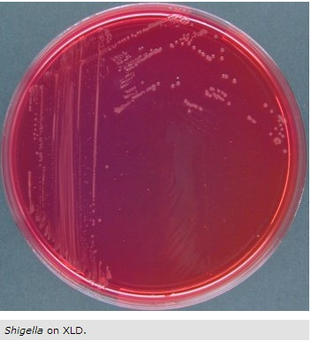

Slide 22
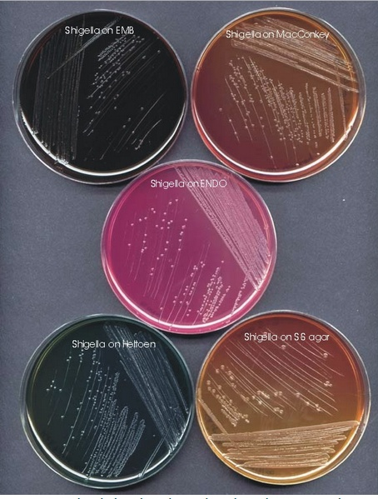

Slide 23
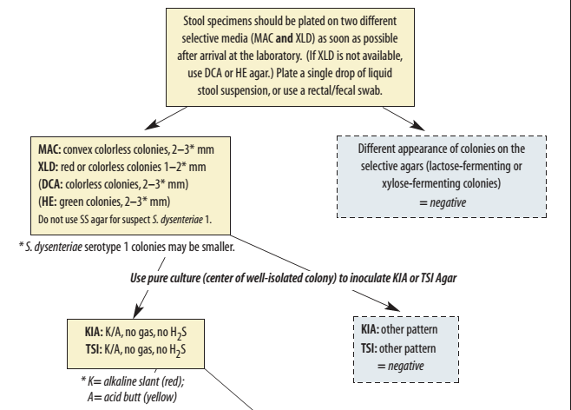
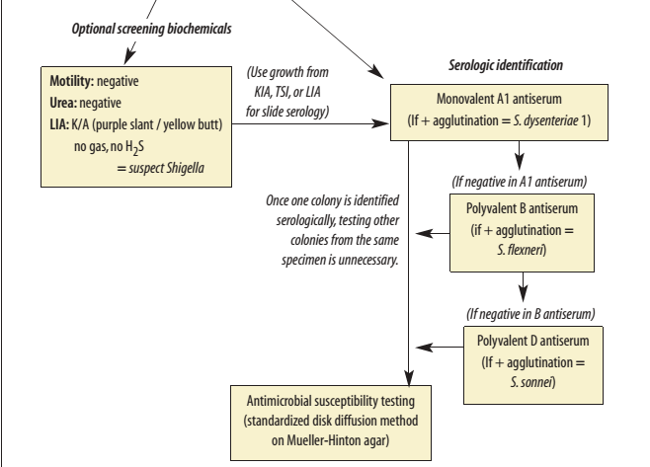

Slide 24
Antibiotics used
ampicillin, ciprofloxacin, norfloxacin, enoxacin, nalidixic acid, pivmecillinam, and trimethoprim-sulfamethoxazole (often referred to as cotrimoxazole).
Unfortunately, resistance of Shigella to ampicillin and trimethoprim-sulfamethoxazole has become widespread.
Nalidixic acid, formerly used as a “backup” drug to treat resistant shigellosis, is now the drug of choice in most areas, but resistance to it has
appeared in many places. When resistant to nalidixic acid,Shigella should be tested with ciprofloxacin; strains resistant to nalidixic acid often exhibit reduced susceptibility to ciprofloxacin.
Pivmecillinam (i.e.,amdinocillin pivoxil) is still effective for most strains of Shigella but may not be readily available. Fluoroquinolones (e.g.,ciprofloxacin, norfloxacin, and enoxacin) are often costly and may not be readily available; fluoroquinolones should be considered only if Shigella isolates are resistant to nalidixic acid.

Slide 25
Prevention
Standard sanitation practices such as sewage disposal and water chlorination
In certain circumstances, insect control may also be important, because flies can serve as passive vectors when open sewage is present.
Good individual sanitary practices, such as handwashing and proper cooking of food,

